Slide 1
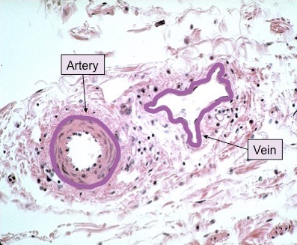
Daily Review
Blood is carried through the body through blood vessels: arteries, veins and capillaries.
Describe the difference in veins and arteries in terms of structure.
Describe the difference in veins and arteries in terms of function.

Slide 2
Daily Review
Match the part of blood to its function
Part of Blood Function
1 Red blood cells A Helps the blood clot after a cut
2 White blood cells B Use haemoglobin to carry oxygen around the body
3 Platelets C Helps regulate body temperature
4 Plasma D Help rid the body of germs

Slide 3
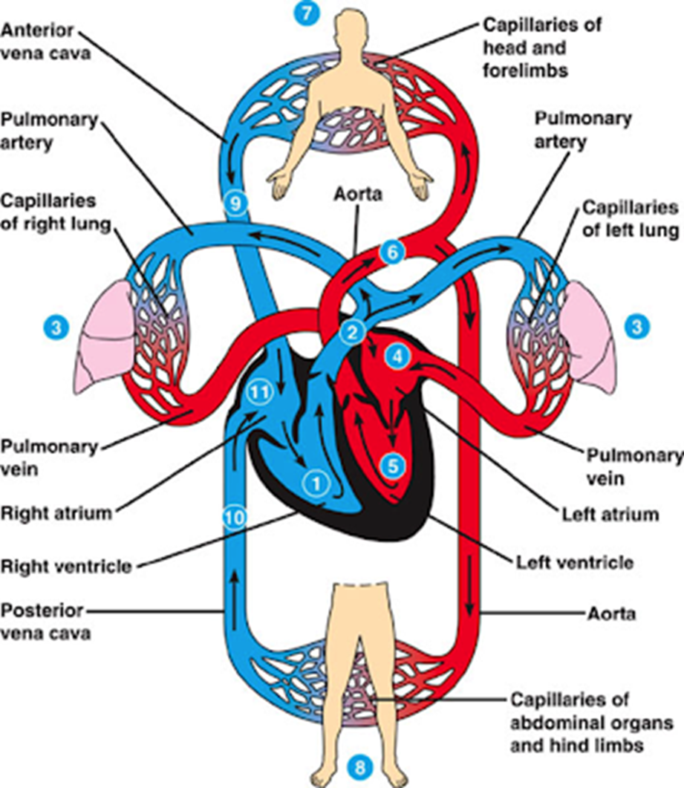
Daily Review
Describing the path of blood through the heart
1. Identify the starting point on the diagram 2. State whether the blood is oxygenated (red) or deoxygenated (blue) 3. Follow the arrows through the different parts of the body
Describe the path of blood from the lungs (3) to the heart.
The oxygenated blood returns to the heart through the pulmonary vein.

Slide 4
Daily Review
Describing the path of blood through the heart
1. Identify the starting point on the diagram 2. State whether the blood is oxygenated (red) or deoxygenated (blue) 3. Follow the arrows through the different parts of the body
Describe the path of blood from the left atrium (4) to the abdominal organs and hind limbs (8).
The oxygenated blood from the left atrium goes to the left ventricle, then goes through the aorta to the abdominal organs and hind limbs.

Slide 5
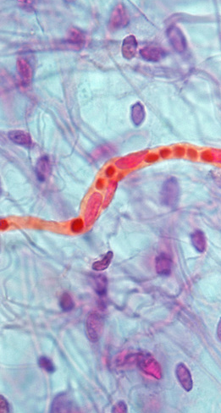
Daily Review
Describing blood vessels
1. If the blood vessel carries blood to individual cells = Capillary 2. Look at the walls of the blood vessel. a) Thick walls = artery b) Thin walls = vein 3. Describe the function of the blood vessel
Describe the blood vessel marked with the arrow.
The blood vessel is a capillary that carries substances to and from cells because it is going to individual cells.

Slide 6
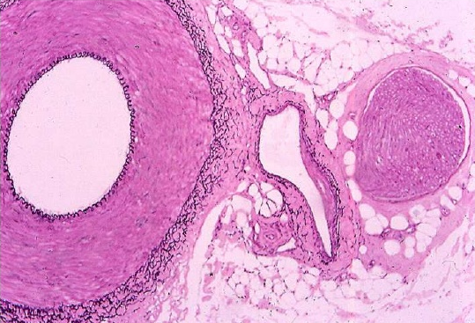
Daily Review
Describing blood vessels
1. If the blood vessel carries blood to individual cells = Capillary 2. Look at the walls of the blood vessel. a) Thick walls = artery b) Thin walls = vein 3. Describe the function of the blood vessel
Describe the blood vessel marked with the arrow.
The blood vessel is an artery that carries blood away from the heart because it has thick, muscular walls.

Slide 7
Daily Review
Describing blood vessels
1. If the blood vessel carries blood to individual cells = Capillary 2. Look at the walls of the blood vessel. a) Thick walls = artery b) Thin walls = vein 3. Describe the function of the blood vessel
Describe the blood vessel marked with the arrow.
The blood vessel is a vein that carries blood towards the heart because it has thin, flexible walls.

Slide 8
Excretory System

Slide 9
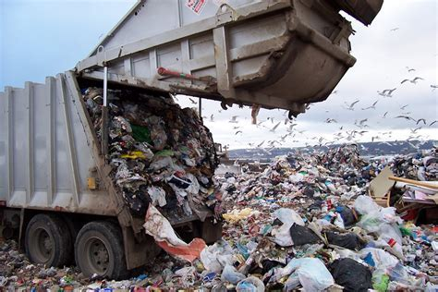
Learning Objectives
CFU
What are we going to learn?
Describe the function of the excretory system.
Identify and describe the function of organs in the excretory system.
Activate Prior Knowledge
Your body produces several waste products that need to be removed from the body.
On your whiteboard, name two waste products that are produced by your body.

Slide 10
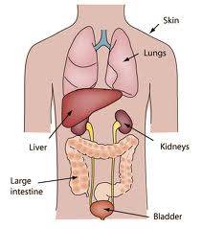
Concept Development
CFU 1
What is the function of the excretory system?
The Excretory System
Our bodies produce a number of substances that need to be removed to avoid damage to our bodies.
Organs in the excretory system are responsible for removing wastes from the body.
These organs include the kidneys, liver, lungs and skin.
CFU 2
Name two excretory organs.
CFU 3
What is excretion?
Vocabulary
Excretion - the process of getting rid of wastes.

Slide 11
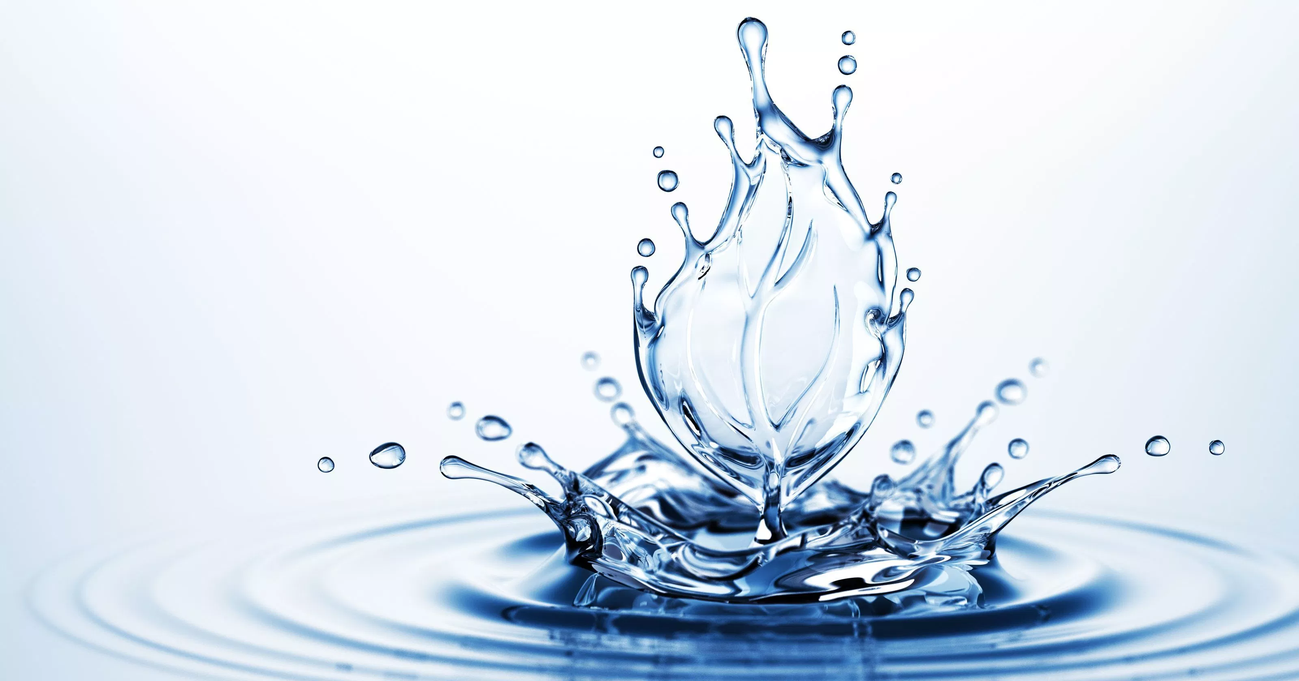
Concept Development
CFU 1
How does water play a part in excretion?
Role of Water
Water is important in controlling wastes.
It can dilute harmful substances, which reduces their impact on the body.
It also helps move substances quickly through the body.
It is essential in regulating body temperature.
Vocabulary
dilute (verb) Reduce the strength or concentration of a solution

Slide 12
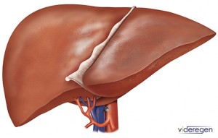
Concept Development
CFU 1
What is the liver responsible for?
The Liver
The liver is responsible for breaking down many substances, especially wastes.
It changes harmful substances into less dangerous forms before their removal from the body.
CFU 2
How does the liver process wastes?
CFU 3
Think, Pair, Share: What is another organ system that the liver plays a role in?

Slide 13
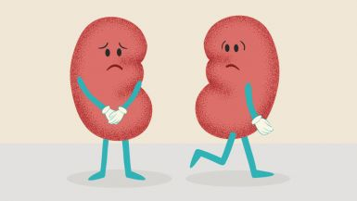
Concept Development
CFU 1
How many kidneys do you have?
CFU 2
What is the function of the kidneys?
The Kidneys and Bladder
You have two kidneys in your body.
Blood carrying waste products passes through the kidneys.
The kidneys filter waste from the blood.
At the end of the filtering process, there are two main products – clean blood and urine.
The bladder stores urine until it is released from the body.
CFU 3
What is produced after the filtering process?
CFU 4
What is the function of the bladder?

Slide 14
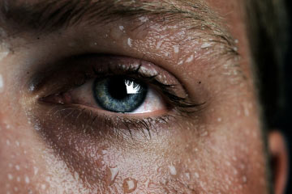
Concept Development
CFU 1
How does the skin release heat?
CFU 2
What is also contained in sweat?
The Skin
The skin releases waste heat by evaporation from wet skin (sweat).
Sweat also contains waste products such as urea and salt.

Slide 15
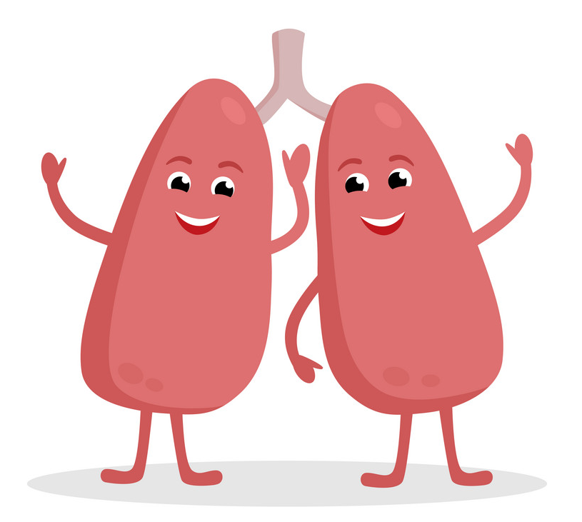
Concept Development
CFU 1
How is carbon dioxide transported to the lungs?
CFU 2
What happens to the carbon dioxide once it reaches the lungs?
The Lungs
Carbon dioxide is produced as a waste product in cells.
Blood carries the carbon dioxide to the lungs.
The carbon dioxide moves into the air inside the lungs and is breathed out.
CFU 3
Think, Pair, Share: In which structures in the lungs does gas exchange occur?

Slide 16
Concept Development
CFU 1
What are proteins broken down into?
CFU 2
What does the liver do to excess amino acids?
Excretory Organs Work Together
When proteins are digested, they are broken down into amino acids.
Your body cannot store excess amino acids, so the liver breaks them down further for energy.
This produces a harmful substance called ammonia, which the liver turns into a chemical called urea.
The urea is transported to the kidneys in the blood.
The kidneys filter out the urea, which leaves the body in urine.
CFU 3
What is produced when the liver breaks down amino acids?
CFU 4
What happens to the urea?

Slide 17
Skill Development/Guided Practice
Collect and complete a graphic organiser using the following information.
The liver breaks down harmful substances. It turns them into less harmful substances so they can be removed by other organs.
The kidneys remove urea from the blood. This is done by filtering the blood as it passes through the kidneys. The urea is released in urine.

Slide 18
Skill Development/Guided Practice
Collect and complete a graphic organiser using the following information.
The skin releases waste heat. Sweat evaporates from the skin, cooling the body. It also contains waste products such as urea and salt.
The lungs remove carbon dioxide from the body. Blood carries the carbon dioxide to the lungs, where it moves into the air inside the lungs and is breathed out.

Slide 19
Relevance
Knowing how organs work together in a system and how the systems interact with each other will help you understand how the body works.
Understanding the structure and function of the excretory system will help you understand how we get rid of waste products produced by the body.

Slide 20
Skill Closure
Excretory Organ Function
1 Liver A Filters blood to remove urea
2 Skin B Removes heat from the body through sweat
3 Kidneys C Removes carbon dioxide produced by cells
4 Lungs D Breaks down harmful substances in the body
Skill Closure
How does water play a part in waste control in the body?
Skill Closure
Explain how the liver and the kidneys work together to excrete waste.

Slide 21
Independent Practice
Complete the rest of the Waste Disposal worksheet.

